Slide 1
Foundation
SQL – Selecting and Filtering

Slide 2

Module Objectives
After completing this module you will be able to:
Retrieve and view data stored within a table
Filter data retrieved based on certain conditions

Slide 3
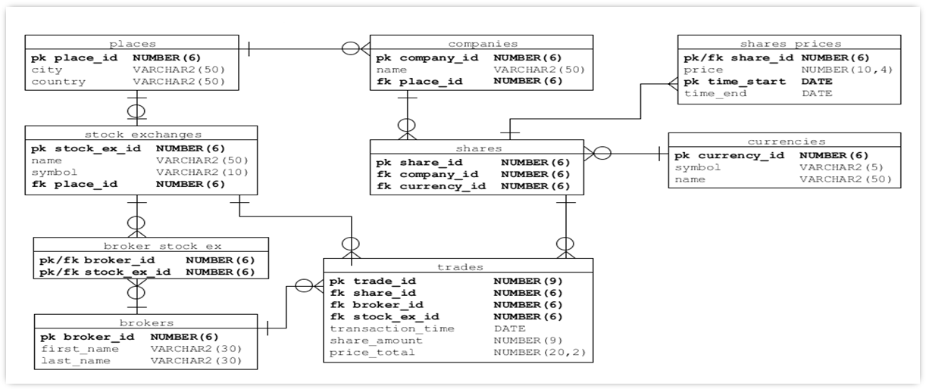
Trading Platform Database Schema

Slide 4
Selecting and Filtering
SELECT
WHERE
ORDER BY
Wildcards
Dates

Slide 5
Scenario
Display details of all trades which have a share amount greater than 3000 and a price total greater than £200,000. For each trade show trade_id, share_id, broker_id, share_amount & price_total.

Slide 6
SELECT
STEP 1: Select the columns to include in the results:
SELECT trade_id,
share_id,
broker_id,
share_amount,
price_total
...

Slide 7
FROM
STEP 2: Choose which table to select the data from :
SELECT ...
FROM trades
...

Slide 8
Executable Query – Try it!
The final query. Try it!
SELECT trade_id,
share_id,
broker_id,
share_amount,
price_total
FROM
trades
;

Slide 9
Selecting and Filtering
SELECT
WHERE
ORDER BY
Wildcards
Dates

Slide 10
WHERE Operators
The WHERE clause is used to filter rows based on certain conditions.
= > >= < <= <> !=
Comparison Operators
Example: WHERE broker_id = 2
Example: WHERE share_amount < 1000

Slide 11
WHERE Operators
Logical Operators
IN – Compares a value to a literal list of values.
Example: WHERE Broker_id IN (1,2,3,5,7)
BETWEEN – Retrieves values that are between a maximum and minimum value.
Example: WHERE Broker_id BETWEEN 1 AND 5
IS NULL – Retrieves null values.
Example: WHERE name IS NULL
LIKE – Compares the contents of strings.
Example: WHERE name LIKE 'Sm%'

Slide 12
WHERE Operators
Boolean Operators
AND : both conditions must be true for the overall result to be true.
OR : one (or both) of the conditions can be true for the overall result to be true.
Example: WHERE broker_id IN (1,2,3,5,7)
AND name IS NULL
NOT : This is a Boolean operator which switches a TRUE result to FALSE:
Examples: WHERE broker_id NOT IN (1,2,3,5,7)
WHERE name NOT LIKE 'Sm%'
WHERE name IS NOT NULL

Slide 13
Arithmetic Operators
Can be used in both SELECT and WHERE clauses to display calculated values or to filter rows based on conditions that involve calculations.
Can be applied to numeric and date values.
+ (addition) - (subtraction) * (multiplication) / (division)
Arithmetic Operators
Example 1:
SELECT product_id,
price * (1 + 0.20)
FROM products;
Example 2:
SELECT product_id
FROM products
WHERE price * (1 + 0.20) > 99.99;

Slide 14
Scenario
Display details of all trades which have a share amount greater than 3000 and a price total greater than £200,000. For each trade show trade_id, share_id, broker_id, share_amount & price_total.

Slide 15
WHERE
STEP 1: The WHERE clause with one condition:
FROM ...
WHERE share_amount > 3000

Slide 16
WHERE
STEP 2: The WHERE clause with two conditions:
FROM ...
WHERE share_amount > 3000
AND price_total > 200000;

Slide 17
Executable Query – Try it!
The final query. Try it!
SELECT trade_id,
share_id,
broker_id,
share_amount,
price_total
FROM
trades
WHERE share_amount > 3000
AND price_total > 200000
;

Slide 18
Selecting and Filtering
SELECT
WHERE
ORDER BY
Wildcards
Dates

Slide 19
ORDER BY
ORDER BY is used to sort results of a query by one or more columns
There are two modes
ASC = Ascending (default)
DESC = Descending
WHERE...
ORDER BY share_id ASC,
broker_id ASC,
price_total DESC,
trade_id ASC;

Slide 20
Scenario
Display details of all trades which have a share amount greater than 3000 and a price total greater than £200,000. For each trade show trade_id, share_id, broker_id, share_amount & price_total. Sort the retrieved records in descending order by price_total.

Slide 21
Final Query – Try it!
SELECT trade_id,
share_id,
broker_id,
share_amount,
price_total
FROM trades
WHERE share_amount > 3000
AND price_total > 200000
ORDER BY share_id,
broker_id,
price_total DESC,
trade_id
;

Slide 22
Selecting and Filtering
SELECT
WHERE
ORDER BY
Wildcards
Dates

Slide 23
Wildcards
String wildcards (Used with LIKE)
%
Represents a string (of any length)
_
Represents a single character only
...
WHERE name LIKE 'T%'
OR name LIKE '_o%'
...
Notes:
The percentage symbol (%) represents (masks) 0 or more characters.
The underscore symbol (_) represents exactly 1 character.

Slide 24
Selecting and Filtering
SELECT
WHERE
ORDER BY
Wildcards
Dates

Slide 25
Date data type - Essentials
Oracle stores values of Date data type in seven separated fixed-length fields of 7 bytes, each corresponding to century, year, month, day, hour, minute, and second
It is important to remember this when working with dates, as it is not as straightforward as working with text or number data types
When comparing dates you will often need to specify, through a format string, what parts of the date you wish to retrieve or compare

Slide 26
Date data type – Introductory Example
To illustrate this, type and run the following query:
SELECT TO_CHAR(SYSDATE, 'DD-MM-YY HH:MI:SS'),
TO_CHAR(SYSDATE, 'CC DAY DD/MM/YYYY HH:MI:SS AM'),
TO_CHAR(SYSDATE, 'CC DY DD/MON/YYYY HH12:MI:SS PM'),
TO_CHAR(SYSDATE, 'CC DAY DD/MONTH/YYYY HH24:MI:SS')
FROM dual
;
SYSDATE function returns the current date & time on your system,
TO_CHAR() function here converts a DATE value to a string in a specified date format
The DUAL table is a ‘dummy’ table in Oracle databases, typically used for selecting data from system functions and calculations when you don’t need any data from the database
Notes:
DD day MM month YY year HH hour MI minute SS seconds
CC = century; DAY = full day name; HH = Hour (01-12); AM = AM/PM
DY = abbreviated day name; MON = abbrev. month name; HH12 = hour (01-12); PM = AM/PM
MONTH = full month name; HH24 = hour (00-23)

Slide 27
Scenario
Display a list of all trades made today.

Slide 28
Final Query – Try it!
SELECT trade_id,
share_id,
broker_id,
share_amount,
price_total,
transaction_time
FROM trades
WHERE transaction_time LIKE SYSDATE;
In this query, try changing LIKE to =
What happens? Why?
Notes:
Note: when filtering by today’s date or a fixed number of days from today’s date we should work directly with SYSDATE, rather than using TO_CHAR.

Slide 29
Scenario
Display a list of all trades made in the last 7 days.

Slide 30
Final Query – Try it!
SELECT trade_id,
share_id,
broker_id,
share_amount,
price_total,
transaction_time
FROM trades
WHERE transaction_time > SYSDATE - 7
;
Notes:
Note: the above query is filtering by a fixed number of days (7) from today’s date; we should therefore work directly with SYSDATE, rather than using TO_CHAR.

Slide 31
Scenario
Display a list of all trades made this month.

Slide 32
Final Query – Try it!
SELECT trade_id,
share_id,
broker_id,
share_amount,
price_total,
transaction_time
FROM trades
WHERE TO_CHAR(transaction_time,'YYMM') =
TO_CHAR(SYSDATE,'YYMM')
;
Notes:
This is the case of filtering by a range of dates which is not a fixed number of days from today. In such cases you should not work directly with SYSDATE; you need to use TO_CHAR function.

Slide 33
Scenario
Display a list of all trades made last month.

Slide 34
Final Query – Try it!
SELECT trade_id,
share_id,
broker_id,
share_amount,
price_total,
transaction_time
FROM trades
WHERE TO_CHAR(transaction_time,'YYMM') =
TO_CHAR(ADD_MONTHS(SYSDATE,-1),'YYMM')
;
Notes:
Note the importance of using ADD_MONTHS to subtract the months from SYSDATE before doing the TO_CHAR
NEVER do arithmetic on the results of a TO_CHAR!!
If you’d tried TO_CHAR(SYSDATE,’YYMM’) -1 it would not work in January. For example if the current date is January 2015, then YYMM is 1501. The previous month December 2014 would be 1412. However if you subtract 1 from 1501 you end up with 1500 which is not a month at all.

Slide 35
Scenario
Display a list of all shares that have changed their price within the same day
Notes:
Note: in order to see meaningful results with the above query, run the ‘update shares_prices’ script, present in LMS

Slide 36
Final Query – Try it!
This is an example of comparing dates from table columns
SELECT share_id,
TO_CHAR(time_start, 'DD-MM-YYYY HH24:MI:SS'),
TO_CHAR(time_end, 'DD-MM-YYYY HH24:MI:SS')
FROM shares_prices
WHERE TO_CHAR(time_start, 'DD-MM-YYYY') =
TO_CHAR(time_end, 'DD-MM-YYYY')
ORDER BY share_id,
time_start DESC
;
Notes:
The above query should return 818 records
Explain why the following filter will not work:
WHERE time_start = time_end -- incorrect (returns nothing as time will differ even if dates are the same)

Slide 37
Examples of comparing dates from table columns – Practice
Write queries to display the following information:
List of all shares that have not changed their price within the same day
List of all shares that have not changed their price yet (don't have time_end set yet)
Notes:
The first query returns 297 records and does not include shares where time_end is NULL; the second returns 8 records: one for each share_id with time_start = the current date
Explain why the following filter will not work for the first query:
WHERE time_start != time_end -- incorrect (returns shares that changed their price within the same day as well, as time will differ); returns 1115 records (297+818)
Explain why the following filter will not work for the second query:
WHERE time_end = NULL -- incorrect; the = comparison operator cannot be used to compare values with NULL (returns no records)

Slide 38
Examples of arithmetic operators applied to date values
Display the hire date of employees who were hired more than a year ago
SELECT employee_name,
hire_date,
FROM employees
WHERE SYSDATE - hire_date > 365
;
Work out the age of employees from their date of birth
SELECT employee_name,
(SYSDATE – birth_date) / 365.25
FROM employees
;

Slide 39
Thinking Points
The query was built in stages - Several intermediate executable queries
Sometimes it is better to build a query in the following way:
FROM
Choose your data sources first
SELECT
Choose the relevant columns
Filter
Only the rows
ORDER BY Important for business purposes and interpreting data
Notes:
In Oracle SQL Developer once you state your table(s) in the FROM clause, you can pick (select) columns within the SELECT clause using the IntelliSense facility. Place the cursor in the SELECT clause and press the space bar to display the list of columns of the tables listed in the FROM clause.
The same applies to all other clauses within the SELECT statement, e.g. WHERE, ORDER BY etc.

Slide 40
Review
What are the core building blocks of a SELECT query?
What is a filter?
What different filter operators are there?
What implications does ORDER BY have on the data?

Slide 41
Questions

Slide 42
Module Objectives
You should now be able to:
Retrieve and view data stored within a table
Filter data retrieved based on certain conditions

